Slide 1
Data Science in Winning the
Space Race
Chen Qi
28 October 2022

Slide 2
TABLE OF CONTENTS
Project Introduction
Methodology
Results
Conclusion
Appendix

Slide 3
Introduction
The rises of SpaceX seems to abridge our distance between us and the Space. More specifically, SpaceX is revolutionary company because it is offering individual rocket launch (i.e. the Falcon 9) at as low as 62 million dollars, whereas other providers spends to 165 millions to do the same things. The decision of SpaceX to reuse the first stage of the rocket launch is the main reason for such a dramatic decrease in cost. Additionally, if they repeat such process, their cost is likely to further decrease. Positioning myself as a data scientist in the rivalry company of SpaceX, in this project, I will create a machine learning pipeline to predict the landing outcome of the first stage of SpaceX. Thus, identifying the right price to bid against SpaceX for a rocket launch.

Slide 4
Introduction
Problems to be solved:
Identifying factors that are significantly affecting the landing outcome.
The relationship between variables and how such correlations affect the landing.
The optimal conditions for successful landings

Slide 5
01
Methodology

Slide 6
Methodology
Executive Summary:
Data Collection
Data Wrangling
Exploratory Data Analysis (EDA) with Visualization and SQL
Interactive Visual Analysis with Folium and Plotly Dash
Predictive Analysis with Classification Model

Slide 7
Methodology - Data Collection
Data Collection is the process of gathering and examining the data that are valuable in finding the answers to our questions. In this project, I applied two methods in collecting related data: From REST APIs and from Web Scraping.
Rest APIs:
It started with the get request. Then, I read and decode the response in JSON form and convert it into a pandas dataframe using json_normalize (). Last but not least, we do a basic cleaning for the data: checking for missing values and fill with according data.
Web Scraping
I use the BeautifulSoup to extract the launch records as HTML tabl and then parse and convert the table into a pandas dataframe for basic cleaning and further operations.

Slide 8
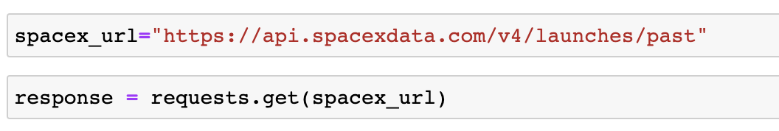
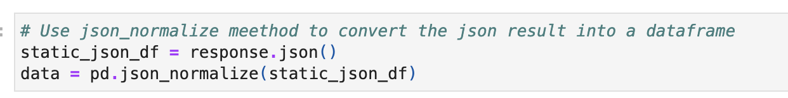
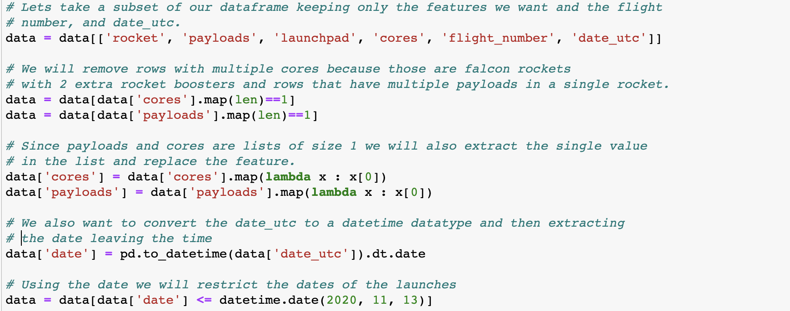
Data Collection - SpaceX API
Identify the data resources and use get() to import it.
Apply json_normalize for converting data into pandas dataframe.
Perform basic data cleaning and filling the missing values,

Slide 9

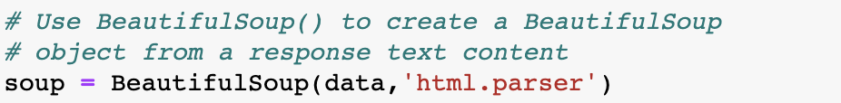
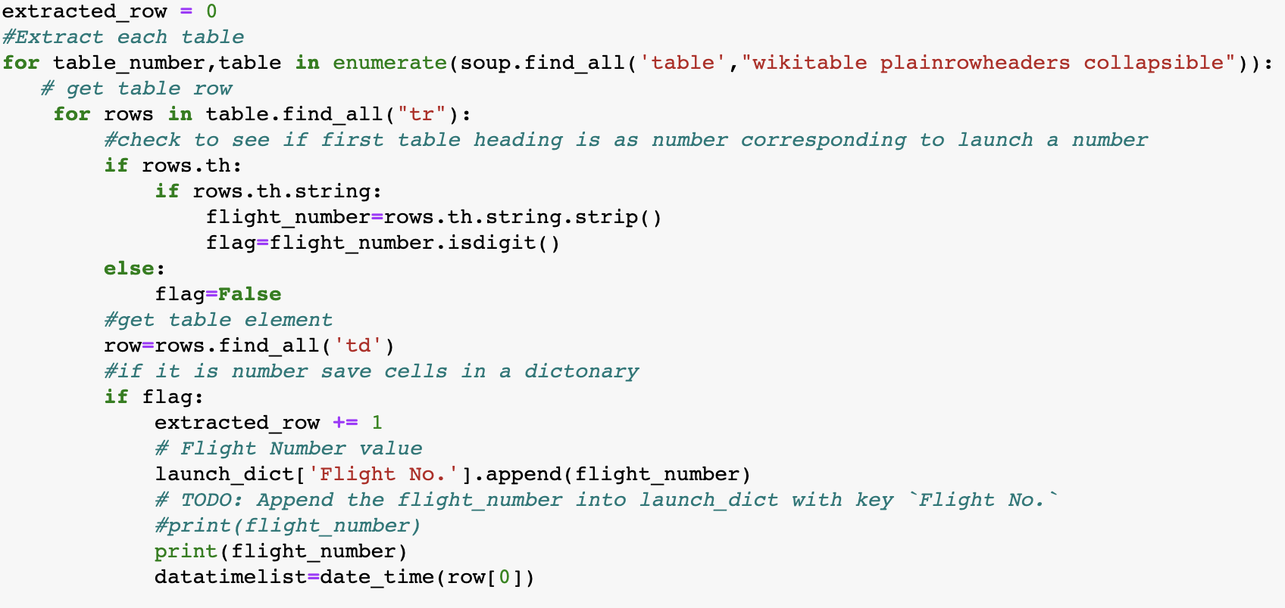
Data Collection - Web Scraping
Obtain the data from our resources
Create a BeautifulSoup object from previous response
Extract every rows and columns we need from previous BeautifulSoup Object

Slide 10
Methodology - Data Wrangling
Exportation
Export the outcome to a csv for further operations.
Concept:
As part of the preprocessing of data, data wrangling will clean and convert complex and messy data into a simpler and more valuable one. As the wrangling is finished, Exploratory Data Analysis can be carried out and the big pictures and general insights of the data can be learnt.
Data Calculation
Calculate the number of launches on each site and the number of mission outcome per orbit type.
3
Labeling
Create outcome label from the outcome column, make it easier for further analysis.
1
2

Slide 11
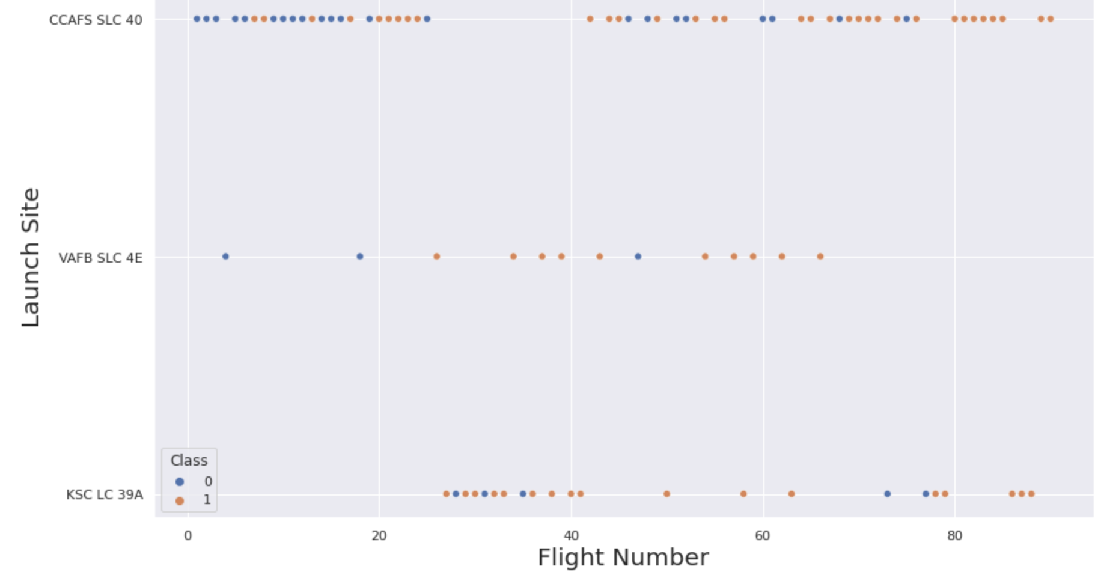
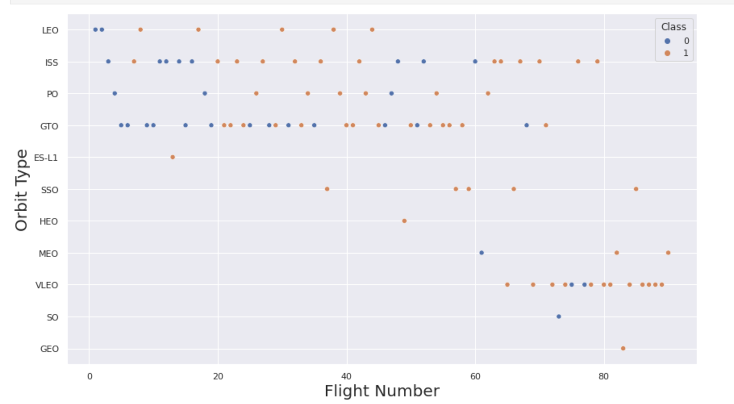
Methodology - EDA with Visualization
First, I would like to use scatter graph to depict relationships between the attributes. Based on the scatter plots we then move on to determine what further visualization is needed. For example, the relationships between these variables are scatter plotted:
Payload and Flight No.
Payload and Orbit Type
Payload and Launch Site
Flight Number and Orbit Type
Flight Number and Launch Site
From the relationship depicted, it can be easily found which factors are affecting the most to the successful landings.

Slide 12
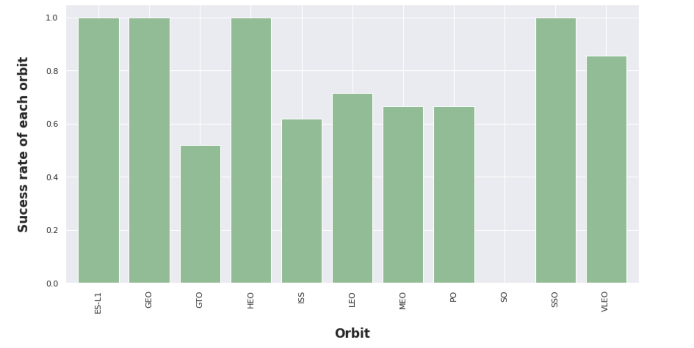
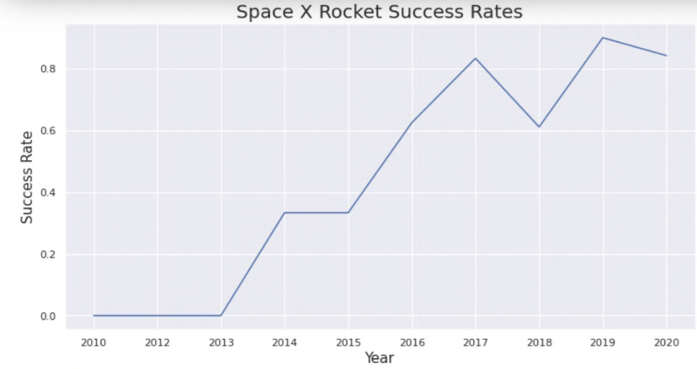
Methodology - EDA with Visualization
From previous results from scatter plot, i move on to further examine the relationship of orbit and successful rate with bar plot.
Then, to generalize a trend of success rate, i move on to draw an line graph, showing how the success rate vary based on time.

Slide 13
Methodology - EDA with SQL
SQL commands provided us with another way of understanding and formatting the data. In this project, i decided to follow the instruction to play around with all the SQL commands and gain more insights from them. However, at this point, i will rely more on the visualization technique for this project. Examples of the sql commands are:
- Listing the date when the first successful landing outcome in ground pad was achieved. - Listing the names of the boosters which have success in drone ship and have payload mass greater than 4000 but less than 6000. - Listing the total number of successful and failure mission outcomes. - Listing the names of the booster_versions which have carried the maximum payload mass. - Listing the failed landing_outcomes in drone ship, their booster versions, and launch sites names for in year 2015. - Rank the count of landing outcomes or success between the date 2010-06-04 and 2017-03-20, in descending order.

Slide 14
Methodology - Advanced Visualization
Dashboard with Plotly Dash
To allow users to better interact and understand the study, i built an interactive dashboard with Plotly Dash. Pie Charts are plotted showing the total launches in different sites. And scatter plots are drawn to show the relationship with outcome and payload mass for different booster version.
Interactive Map with Folium
To visualize the launch data into a interactive map, I took the coordinates at each launch site and add a marker around them with introduction on the label.
I then assigned the dataframe launch_outcomes to class 0 (failure) and 1 (success) with Red and Green markers.
Then, the answers to question like “ How close the launch sites with railways, highways and coastlines?” can be easily answered by the map.

Slide 15
Methodology - ML Analysis (Classification)
Building the Model
Model Evaluation
Model Improvement
Find the Best Model
While building the models, we need to: split the training and evaluating set; Decides what ML models to use; and set parameters and algorithms to GridSearchCV and fi the data
Plot the confusion matrix; Get tuned hyperparameters for each type of algorithms; examine the overall
Apply Feature Engineering and Algorithm Tuning.
Select the model with best accuracy as the final model.
1
2
3
4

Slide 16
02
Results

Slide 17
Results
In this section of the report, I will demonstrate the results mainly from 3 different perspectives:
Exploratory Data Analysis (EDA) results
Carried out three most outstanding correlations I found while doing EDA with visualization.
Interactive Analytics demo in screenshots
Predictive analysis results

Slide 18
EDA ANALYSIS

Slide 19
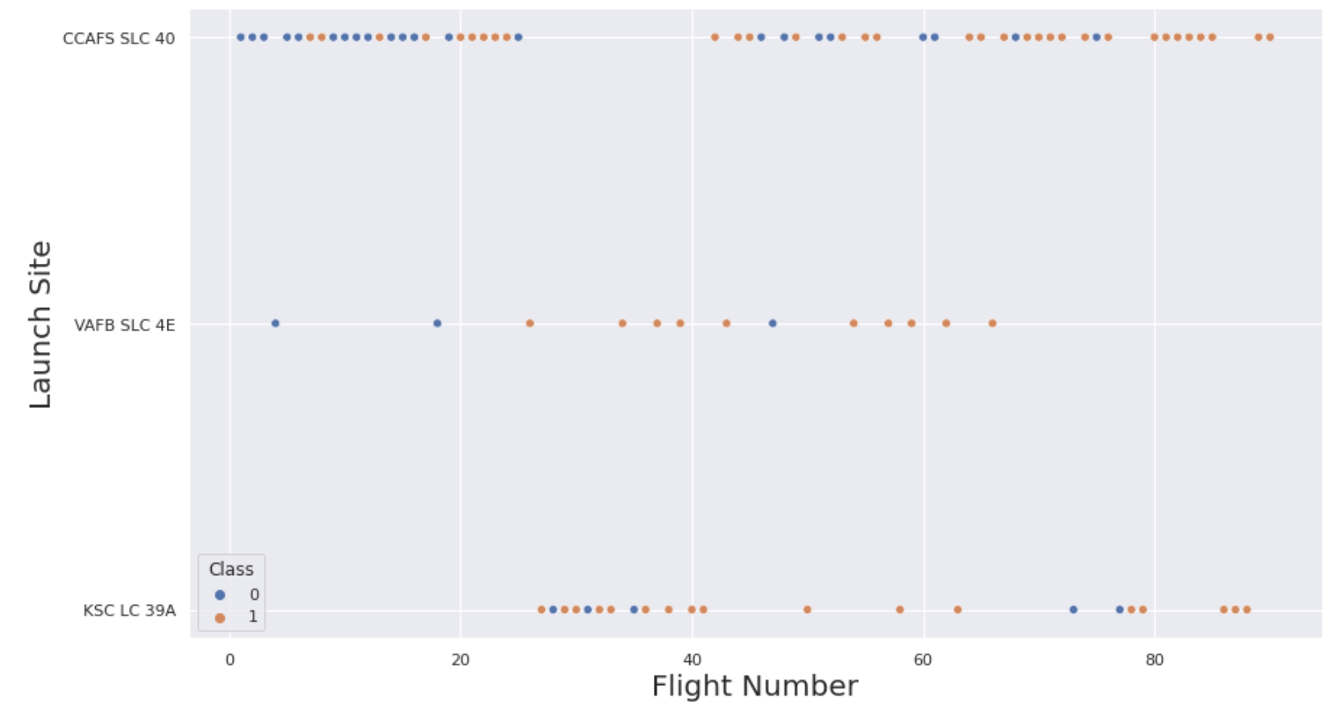
Results - Insights from EDA
Flight Number vs. Launch Site
The scatter plot between Flight number and Launch Site shows that sites with larger flight number ten to have a greater chance of successfully launching.
However, site CCAFS SLC40 shows the least pattern of this general trend.

Slide 20
Results - Insights from EDA
Success Rate vs. Orbit Type
From the bar graph, the fluctuation of successful landing rate fluctuates at different orbits.
The ES-L1, GEO, HEO, and SSO orbits seem to be the safest for landing.
While the GTO orbit is showing a very low possibility of successful landing.

Slide 21
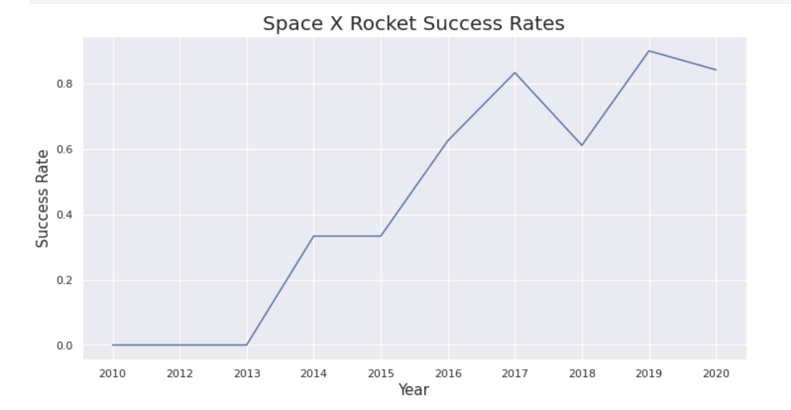
Results - Insights from EDA
Success Rate vs. Orbit Type
From the line graph, it is not hard to find that the successful rate of landing is generally increasing as time passes by from 2010-2020.
However, what is worth noticing is that there is a decrease in success rate at 2018. When conducting further analysis, we need to keep this special time in mind.

Slide 22
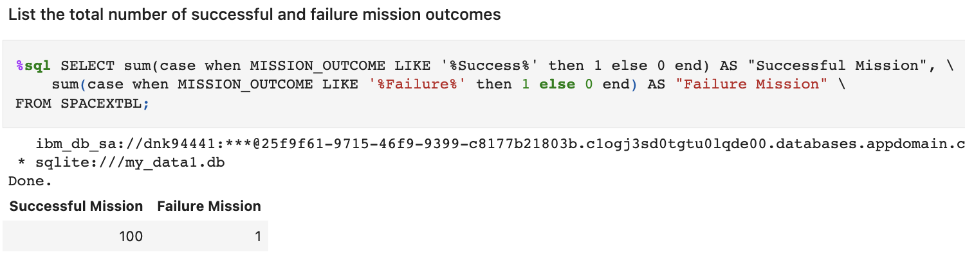
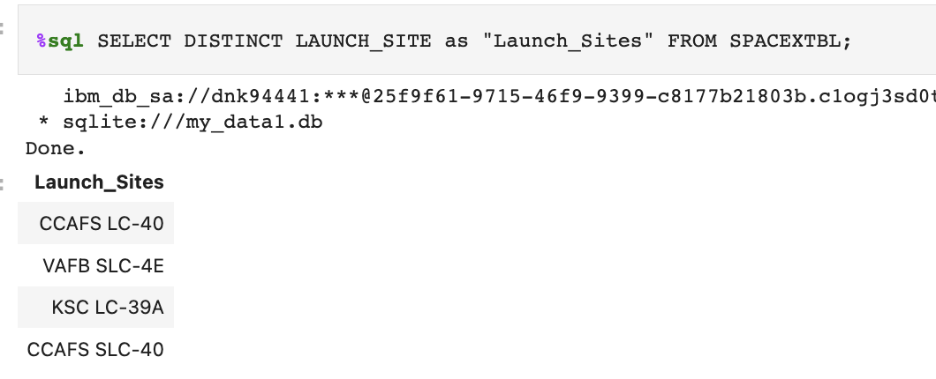
Results - SQL exploration
I used wildcard like % to filter WHERE MissionOutcome was a success or a failure
Used DISTINCT function to show only unique launch sites from SpaceX data.

Slide 23
Launch Sites
Proximities Analysis

Slide 24
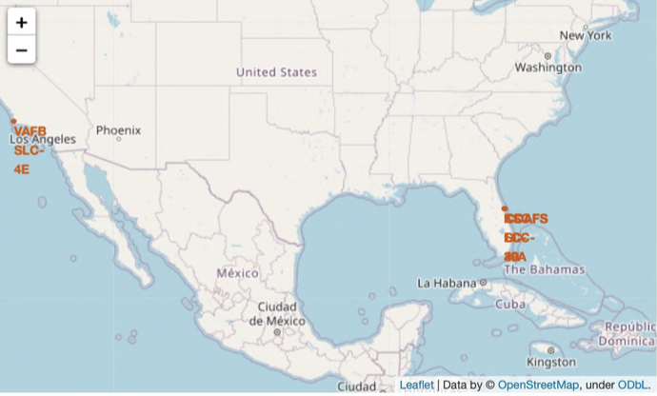
Results - Map
From this map covering the space of the United States, we can see where each Launch sites are located

Slide 25
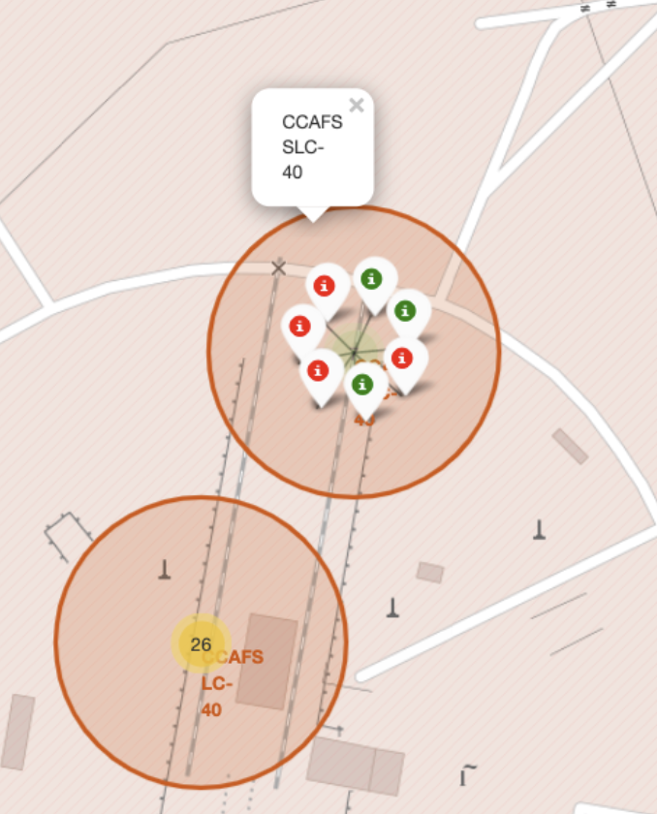
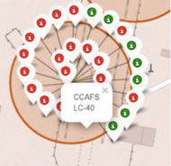
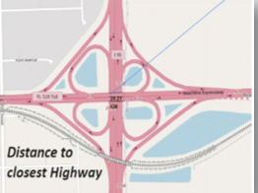
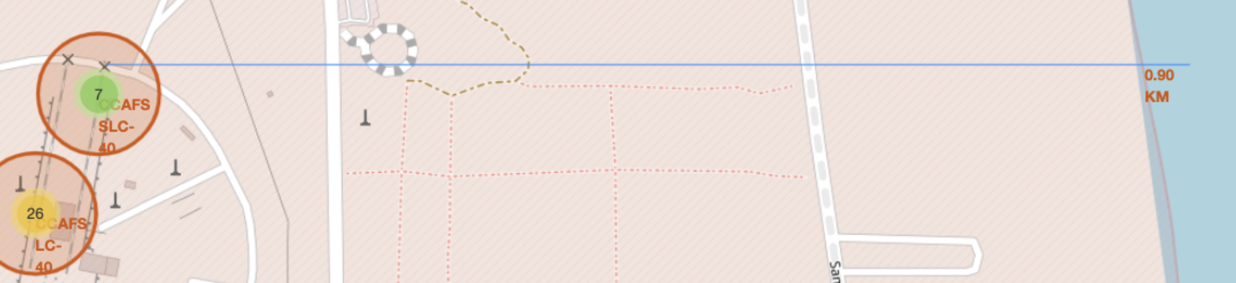
Results - Proximities Analysis
From the maps and the labels, a concise structure of these locations can be built and vividly shown to the users. Not only can we see the success rate at each site, wen can also observe that how different proximity to city structure influence the success rate.

Slide 26
Dashboard
With Plotly Dash

Slide 27
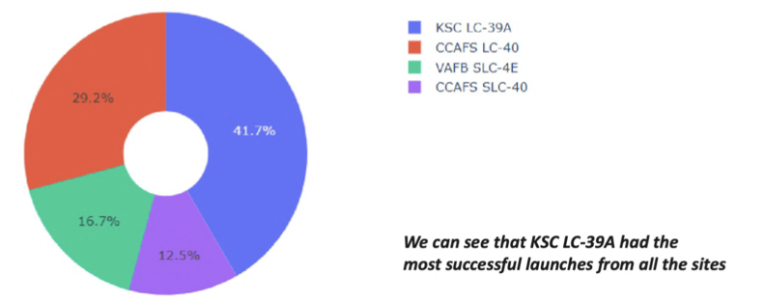

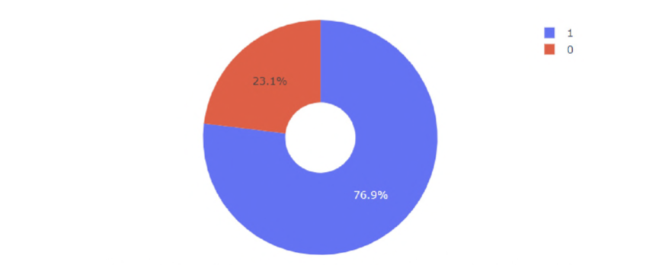
Results - Dashboard
From the dashboard, not only can we see how the successful launches are distributed among different sites.
We can also zoom in to see how the success rate is for each site. For example, the pie chart to the right shows that KSC LC-39A achieved a 76.9% success rate.

Slide 28
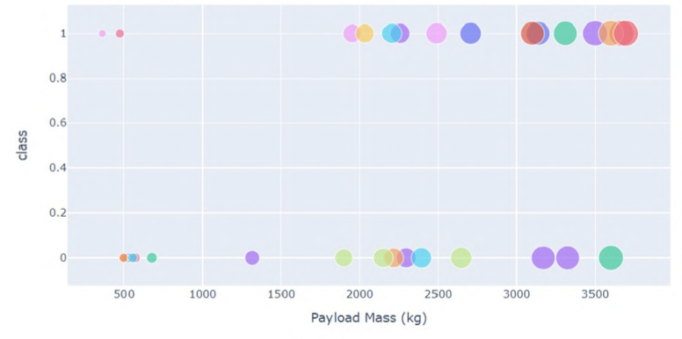
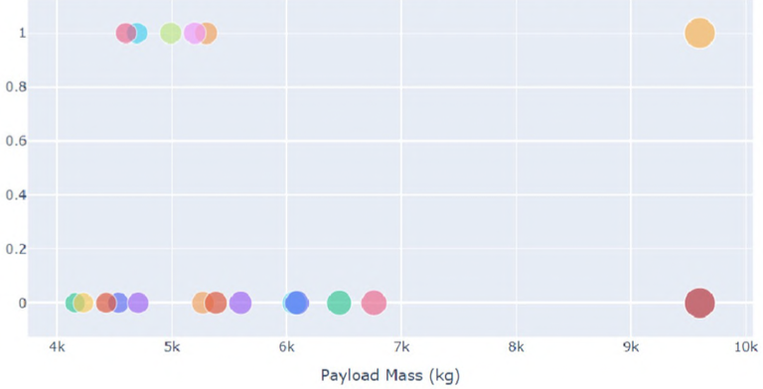
Results - Dashboard
Through Dashboard, we can also view how the success rate vary from low-weight payload mass to high-weight payload mass. We can see that the success rate for low-weight payload mass is seriously higher than that of the high-weight payload mass.

Slide 29
Predictive Algorithms
Classification Models

Slide 30
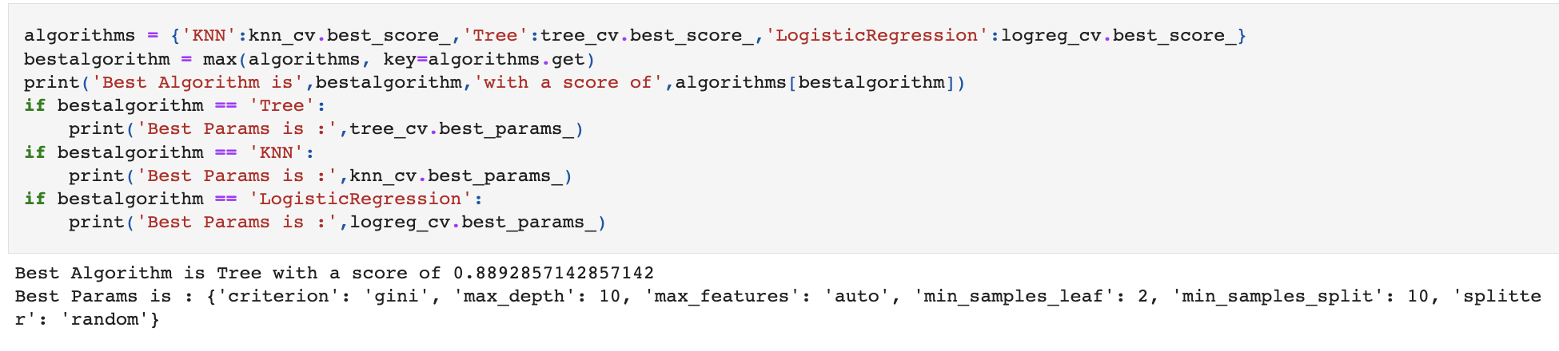
Results - Algorithm Accuracy
As we can see from the output from the code below, we could identity the best algorithm for this project to be the Tree Algorithm due to its highest classification accuracy.

Slide 31
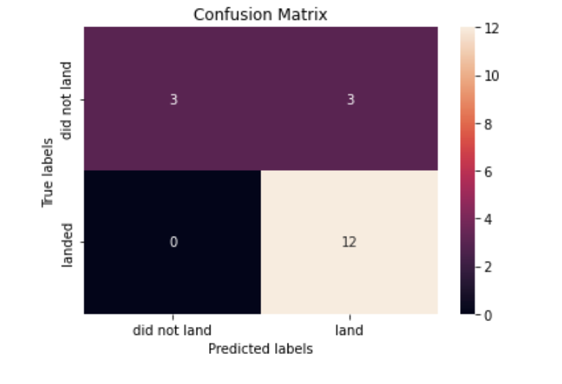
Results - Confusion Matrix
The confusion matrix for the decision the classifier shows that the classifier can distinguish between the different classes. The major problem is the false positives. That is unsuccessful landing marked as successful landing

Slide 32
03
Conclusion

Slide 33
Results - Classification Accuracy
Here are the final conclusions:
The Tree Classifier Algorithm is the Machine Learning that best fits the need of our project.
The weight of payloads can be a significant influence to whether a a landing is successful. More specifically low-weight payloads (<4000kg) perform much better.
KSC LC-39A has the most successful launches of any sites at 76.9%
Starting from the year 2013, the success rate for SpaceX launches is increased, directly proportional time in years to 2020, which it will eventually perfect the launches in the future.

Slide 34
03
Appendix

Slide 35
Appendix
Resources of Codes:
Data Collection
From APIs: https://github.com/ChenQi000320/SpaceY-Project---IBM-DS/blob/master/jupyter-labs-spacex-data-collection-api.ipynb
WebScraping:
https://github.com/ChenQi000320/SpaceY-Project---IBM-DS/blob/master/jupyter-labs-webscraping.ipynb
Data Wrangling: https://github.com/ChenQi000320/SpaceY-Project---IBM-DS/blob/master/labs-jupyter-spacex-Data%20wrangling.ipynb

Slide 36
Appendix
Resources of Codes:
EDA with Data Visualization:https://github.com/ChenQi000320/SpaceY-Project---IBM-DS/blob/master/jupyter-labs-eda-dataviz.ipynb
EDA with SQL:https://github.com/ChenQi000320/SpaceY-Project---IBM-DS/blob/master/jupyter-labs-eda-sql-coursera_sqllite.ipynb
Data Mapping:https://github.com/ChenQi000320/SpaceY-Project---IBM-DS/blob/master/lab_jupyter_launch_site_location.ipynb
Dashboard:https://github.com/ChenQi000320/SpaceY-Project---IBM-DS/blob/master/spacex_dash_app.py
Prediction (Classification Model):https://github.com/ChenQi000320/SpaceY-Project---IBM-DS/blob/master/SpaceX_Machine%20Learning%20Prediction_Part_5.ipynb

